Slide 1
Number Systems

Slide 2
Number Systems
The number system is a way to represent or express numbers.
You have heard of various types of number systems such as the whole numbers and the real numbers.
But in the context of computers, we define other types of number systems. They are:
The decimal number system
The binary number system
The octal number system and
The hexadecimal number system

Slide 3
Number Systems & Description
S.No. | Number System and Description
1 | Decimal Number System Base 10. Digits used : 0 to 9
2 | Binary Number System Base 2. Digits used : 0, 1
3 | Octal Number System Base 8. Digits used : 0 to 7
4 | Hexa Decimal Number System Base 16. Digits used: 0 to 9, Letters used : A- F

Slide 4
Decimal Number System
The number system that we use in our day-to-day life is the decimal number system. Decimal number system has base 10 as it uses 10 digits from 0 to 9. In decimal number system, the successive positions to the left of the decimal point represent units, tens, hundreds, thousands, and so on.
Each position represents a specific power of the base (10). For example, the decimal number 1234 consists of the digit 4 in the units position, 3 in the tens position, 2 in the hundreds position, and 1 in the thousands position. Its value can be written as
(1 x 1000)+ (2 x 100)+ (3 x 10)+ (4 x l)
(1 x 10³)+ (2 x 10²)+ (3 x 10¹)+ (4 x l0⁰)
1000 + 200 + 30 + 4 1234

Slide 5
Binary Number System
Characteristics of the binary number system are as follows −
Uses two digits, 0 and 1
Also called as base 2 number system
Each position in a binary number represents a 0 power of the base (2). Example 2⁰
Last position in a binary number represents a x power of the base (2). Example 2^{x} where x represents the last position
Example ((1 x 2⁴) + (0 x 2³) + (1 x 2²) + (0 x 2¹) + (1 x 2⁰))

Slide 6
Calculating Decimal Equivalent
Step | Binary Number | Decimal Number
Step 1 | 10101₂ | ((1 x 2⁴) + (0 x 2³) + (1 x 2²) + (0 x 2¹) + (1 x 2⁰))₁₀
Step 2 | 10101₂ | (16 + 0 + 4 + 0 + 1)₁₀
Step 3 | 10101₂ | 21₁₀

Slide 7
Octal Number System
Characteristics of the octal number system are as follows −
Uses eight digits, 0,1,2,3,4,5,6,7
Also called as base 8 number system
Each position in an octal number represents a 0 power of the base (8). Example 8⁰
Last position in an octal number represents a x power of the base (8). Example 8^{x} where x represents the last position
Example ((1 x 8⁴) + (2 x 8³) + (5 x 8²) + (7 x 8¹) + (0 x 8⁰))

Slide 8
Calculating Decimal Equivalent
Step | Octal Number | Decimal Number
Step 1 | 12570₈ | ((1 x 8⁴) + (2 x 8³) + (5 x 8²) + (7 x 8¹) + (0 x 8⁰))₁₀
Step 2 | 12570₈ | (4096 + 1024 + 320 + 56 + 0)₁₀
Step 3 | 12570₈ | 5496₁₀

Slide 9
Hexa-decimal Number System
Characteristics of the octal number system are as follows −
Uses 10 digits and 6 letters, 0, 1, 2, 3, 4, 5, 6, 7, 8, 9, A, B, C, D, E, F
Letters represent the numbers starting from 10. A = 10. B = 11, C = 12, D = 13, E = 14, F = 15
Also called as base 16 number system
Each position in a hexadecimal number represents a 0 power of the base (16). Example, 16⁰
Last position in a hexadecimal number represents a x power of the base (16). Example 16^{x} where x represents the last position
Example ((1 x 16⁴) + (9 x 16³) + (F x 16²) + (D x 16¹) + (E x 16⁰))

Slide 10
Calculating Decimal Equivalent
Step | Binary Number | Decimal Number
Step 1 | 19FDE₁₆ | ((1 x 16⁴) + (9 x 16³) + (F x 16²) + (D x 16¹) + (E x 16⁰))₁₀
Step 2 | 19FDE₁₆ | ((1 x 16⁴) + (9 x 16³) + (15 x 16²) + (13 x 16¹) + (14 x 16⁰))₁₀
Step 3 | 19FDE₁₆ | (65536+ 36864 + 3840 + 208 + 14)₁₀
Step 4 | 19FDE₁₆ | 106462₁₀

Slide 11
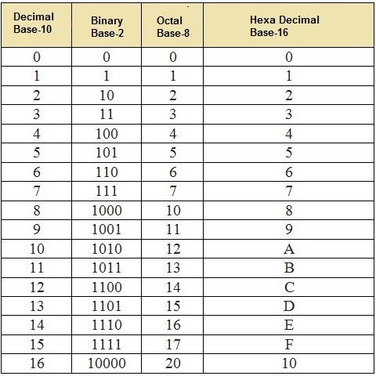
Equivalent Numbers

Slide 12
Number System Conversions
Decimal to binary
Binary to decimal
Decimal to Octal
Octal to Decimal
Decimal to hexa-decimal
Hexa-decimal to decimal

Slide 13
Number System Conversions: Assignment
Octal to binary: Octal -> Decimal -> Binary
Binary to Octal: Binary -> Decimal -> Octal
Hexa-decimal to Octal: Hexa -> Decimal -> Octal
Octal to hexa-decimal: Octal -> Decimal -> Hexa
Binary to hexa-decimal: Binary -> Decimal -> Hexa
Hexa-decimal to binary: Hexa -> Decimal -> Binary

Slide 14
THE END

